Slide 1
FOCUS ON TEACHING AND LEARNING
TAKING ENGAGED LEARNING ONLINE
FACULTY PANEL
Dinko Bačić
Vicky Kynourgiopoulou
Cynthia Stewart (Moderator)
Natasha Teetsov

Slide 2
WELCOME TO THE FOTL SESSION
Thank you for joining us.
We are recording this session
If you have any questions, please use the Chat box and we will have allotted time at the end of the session for dialogue with panelist.
Copies of the PowerPoint will be available.
Notes:
Time (5 minutes)
Include name, title, department, experience teaching online

Slide 3
PANEL INTRODUCTIONS

Slide 4
Timing
Intro - 5 minutes total, self intro
Engaged Learning Defined - 2 minutes
Polls - 5 minutes
Question 1 - 10 minutes
Question 2 - 10 minutes
Question 3 - 10 minutes
Faculty questions - 18 minutes
Notes:
Time (5 minutes)

Slide 5
PANEL INTRODUCTIONS
Dinko Bačić
School of Business
Email: dbacic@luc.edu
Vicky Kynourgiopoulou
College of Arts and Sciences
Email: vkynou@luc.edu
Cynthia Stewart (Moderator)
Center for Experiential Learning
Email: cstewart8@luc.edu
Natasha Teetsov
School of Continuing and Professional Studies
Nteetsov@luc.edu
Notes:
Time (5 minutes)
Include name, title, department, experience teaching online

Slide 6
LEARNING OUTCOMES

Slide 7
TODAY’S LEARNING OBJECTIVES
Explore how to effectively design an online course for students to learn new content and to apply this content in a real-world setting
Share best practices to foster community engagement in an online classroom
Connect the Jesuit values to project based work

Slide 8
ENGAGED LEARNING
DEFINED

Slide 11
HAVE YOU TAUGHT AN ENGAGED LEARNING COURSE?
PULSE CHECK: POLL

Slide 12
HAVE YOU TAUGHT AN ONLINE COURSE?
PULSE CHECK: POLL

Slide 13
HAVE YOU TAUGHT AN ENGAGED LEARNING COURSE ONLINE?
PULSE CHECK: POLL

Slide 14
QUESTIONS FROM THE MODERATOR
ASKING OUR PANELISTS

Slide 15
PANEL QUESTION
Why and how why do you prepare your students for the engaged learning experience?
Notes:
Natasha: Second
Civic-minded graduate
Asset based community model
Focus more on what the community needs and not what you want to do
Leverage your networks
Rely on your classmates and instructor for support through live progress reports and midterm progress presentations
“chunked” the graded works so students cannot fall into the trap and temptation of procrastination
Dinko - First
Why:
Clarify and amplify the impact (to student, community, client, Loyola)
Provide the link between courses/curriculum and the application
Preparation for the ‘real world’
crisp focus on practicality and relevance
How
closely-coupled integration of material/video with skill required to succeed
gradual reveal of required skills
spend time ensuring success upfront (ensure fit between project needs, student skills, interests and impact)
clarity of what success means (show old project - video, deliverables, etc; contract, community/client presentation)
consider integrating with student competitions
●Vicky – Third
●Course objectives and community engagement model
●Mission as global citizens
●Why engaged learning is important for personal and professional development
●Part of the University’s mission
How:
•Clear objectives and expectations
•Continuous monitoring of student work, concerns, questions
•Relevance of everyday work with course information
•Deliberate course activities to enhance the above
Active learning model

Slide 16
PANEL QUESTION
How do you “show up” to support your students in the engaged learning process?
Notes:
Natasha - First
Clear learning outcomes listed each week - consistency from week to week
Offer regular one-on-one meetings via zoom or via cell phone
Offer extra credit for sharing contact information; picture must be visible in the forum
Send out weekly Voicethread announcements in conjunction with announcement text
Synchronous sessions that include structure breakout sessions
Alumni guests to explain project experience during a live Zoom session and as leaders in discussion forums
Provide audio feedback for written assignments to hear tone
Importance of using first names in feedback
Dinko - Third
Empathy
Clarity (minimise need to any non-critical thinking follow up or clarification)
Transparency (expectations clear, no surprises, always know how you are doing in class)
Be responsive
Aim to achieve ‘flow’ - control and emotion
Survey findings (n=113) (Scale 1 - 7):
Practical value 6.75
Tracking my progress 6.73
Relevancy to my career 6.67
Demonstration by the instructor 6.61
Instructor availability 6.61
Module consistency 6.58
Instructor expertize 6.54
Theoretical explanation (why?) 6.54
Module fit into course objectives 6.41
Pedagogical approach understanding 6.17
Course feedback 5.93
●Vicky – Second
●Student-faculty contact (through introductions, announcements, online office hours, prompt response to student questions about coursework or course material/ concerns)
●Clear instructions regarding deadlines, coursework, academic policy, participation and expectations
●Multiple means of instruction, engagement, and assessment
●Keep student and placement agent in contact through scheduled meetings and feedback
●Update course material on sakai
●Model course netiquette at the beginning of the semester with specific introductions
●Ask students for feedback about the course on a regular basis and revise content as needed
●Inform students of the response time they should expect
●Inform students of whom to contact with course questions if the instructor is unable to teach or needs to be absent

Slide 17
PANEL QUESTION
What are successes you have experienced in your courses? Challenges? Opportunities?
Notes:
Vicky: First
Opportunities:
•Clear expectations and relevance of mission with placement opportunity
•Relevance between course material and the real world
•Social pressure through group work
•Be prepared to answer questions from peers and community members
•Group work and how each student plays a part in the project
•Time invested to prepare, monitor and feed course with updated information
•Empathy for different student time zones
•Challenges:
•Different time zones
•Students’ inability to commit to respecting course deadlines
•Students feeling remote-disengaged
•Important Note: Need to have clear, concrete objectives and move backwards in course development
Natasha: Third
Use CEL resources
Do significant prep work about what is community, identity, systemic oppression in our communities, active listening and Jesuit values
Explore the difference between volunteering and community engagement
Jesuit values in practice
Opportunity to try civic engagement since we rarely have this time carved out while also having support and feedback
Dinko - Second
Success
Experiential learning approach - focus on learning by doing and then reflecting - teching tools in online MOOC setting is possible
Focus on building-up students
engaged learning goes well with my discipline, skill sets
Co-creation focus
Thinking of student teams as a consulting practice
Cross-discipline teams
Challenges (work up front is critical vs a mechanism to control progress)
Team formation
Client - Team - Goals fit
Accountability
Be ok for teams to discover and learn on their own/control/it can be messy
Natasha:
Confirmation of site information and learning contract
Also a way to initiate conversation with site partners and build connections and community

Slide 18
QUESTIONS FROM THE AUDIENCE
ASKING OUR EXPERTS

Slide 19
ADDITIONAL PANEL QUESTIONS
How do you assess/measure and communicate success in an online, engaged learning course?
How do you incorporate student reflection in an online course?
How do you teach technology and other skills required for student success?
What are some general teaching/course structure practices that can enable experiential learning?
How do you enable real-time student feedback to improve your course?
Notes:
Natasha:
Confirmation of site information and learning contract
Also a way to initiate conversation with site partners and build connections and community
Dinko
Have pre and post course survey assessing students perception of their ability to perform tasks associated with course objective

Slide 20
LOYOLA FACULTY RESOURCES
LINKS

Slide 21
LOYOLA FACULTY RESOURCES
Academic Continuity Working Group Resources for LUC Faculty
LUC Engaged Learning
Center for Experiential Learning faculty resource
Faculty Center for Ignatian Pedagogy
Office of Online Teaching

Slide 22
THANK YOU
Please reach out to us with any questions that might arise after the session.
Dinko Bačić
School of Business
Email: dbacic@luc.edu
Vicky Kynourgiopoulou
College of Arts and Sciences
Email: vkynou@luc.edu
Cynthia Stewart
Center for Experiential Learning
Email: cstewart8@luc.edu
Natasha Teetsov
School of Continuing and Professional Studies
Nteetsov@luc.edu

Slide 23
APPENDICES
ADDITIONAL INFORMATION

Slide 24
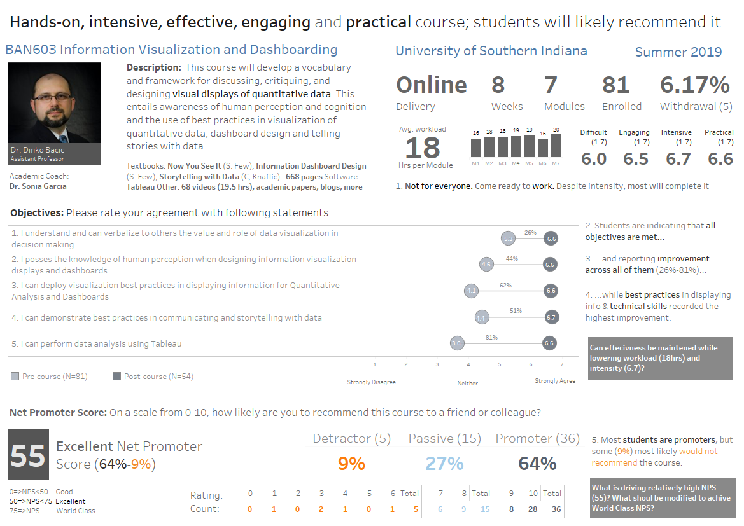

Slide 25
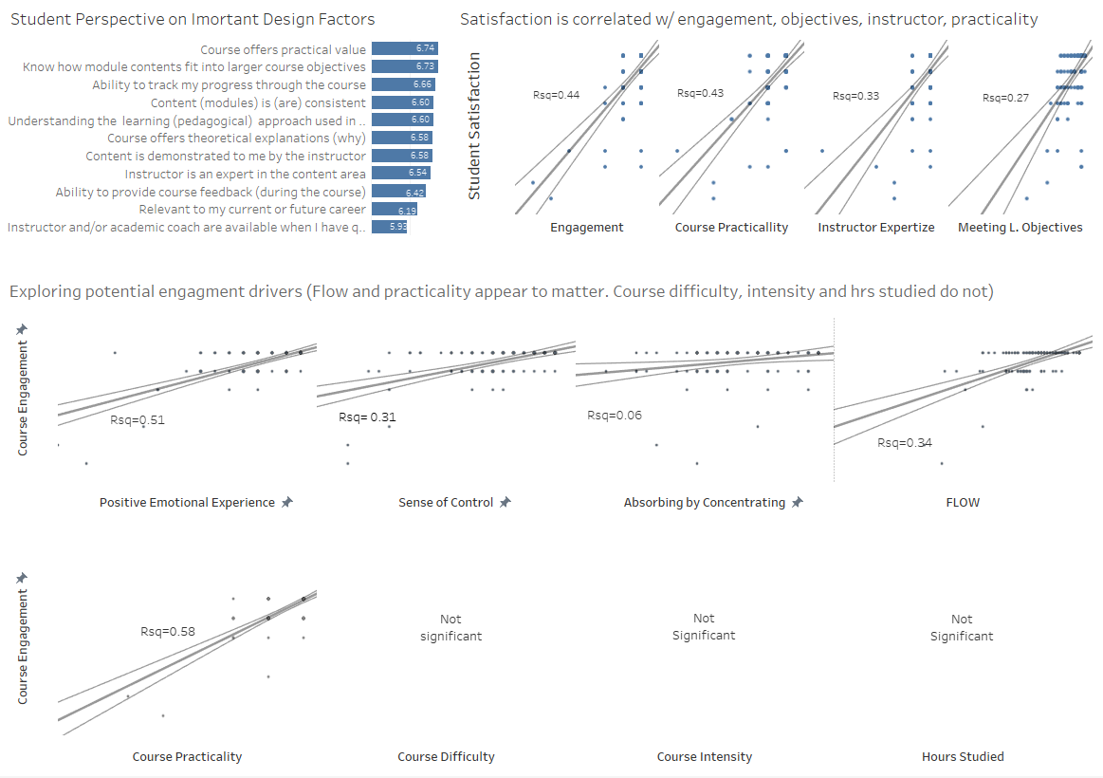
n=113, 2 MBA courses

